Slide 1

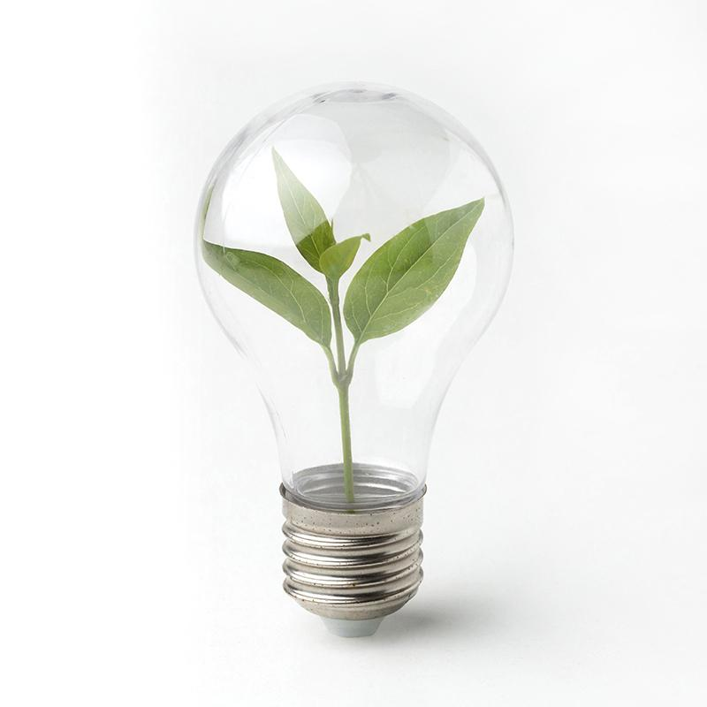
Smart Energy Consumption
One step towards Smart City

Slide 2
Our Team
01.
02.
03.
04.
Mohammed Imran Ali
B.Tech 2nd ECE GNITC
M.Lokesh Reddy
B.Tech 2nd ECE GNITC
M.Yashwanth Kumar
B.Tech 2nd ECE GNITC
M. Lahari
B.Tech 2nd ECE GNITC
22WJ1A04G3

Slide 3
01
Objectives of the project

Slide 4


Objectives of the project
1. Control and optimization of energy
2. Autonomous and Independent
3. Step towards Smart City
4. Support to Digital India
5. Cost Optimization
6. Conserving Energy and making a Sustainable Earth

Slide 5
02
Problem

Slide 6
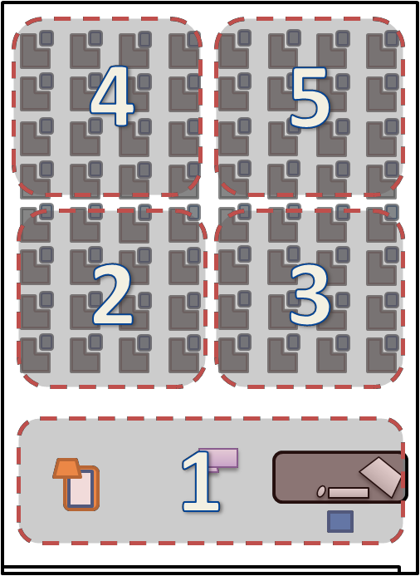
Unwanted consumption and
Wastage
of
Energy
Occupancy
of Hall

Slide 7
Device | Avg. Rating | Energy consumed per minute
Fan | 75W | 4.5 kJ
LED Panel/ Bulb/ Tube | 25W | 1.5 kJ
Total Energy consumed per minute
6.0 kJ
Total Energy consumed per minute for a classroom
30.0 kJ
Total Energy consumed per hour for a classroom
18.0 MJ
(0.5kWh)

Slide 8
According to United States Environmental Protection Agency
For Producing 1kWh of Energy,
approx. emmision of 1Kg of Harmful and Toxic Pollutants
Toxic Pollution leads to:
Ocean / Rain Acidification
Climate Change
Global Warming
Sea Level Rise
Air Quality
CVR Problems
Ozone Depletion
1 kWh = ₹6.4

Slide 9
Save Energy today for a brighter, sustainable tomorrow.
Every watt saved is a step towards a greener Earth."

Slide 10
03
Solution Working Principle

Slide 11

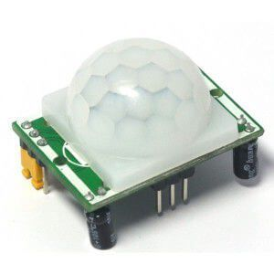
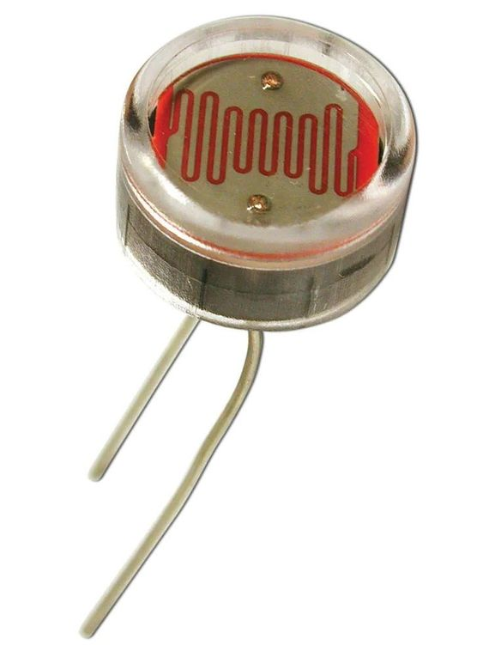
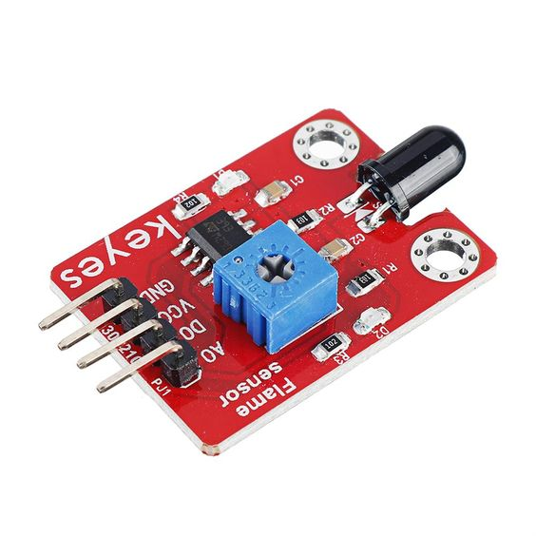
Solution
Sensors:
Motion (PIR)
Light Intensity (LDR)
Flame
Microcontroller
Arduino

Slide 12
Working Principle
Detection / Arduino
Flame
Light Intensity
Motion
Alarm
Fans
Light

Slide 13
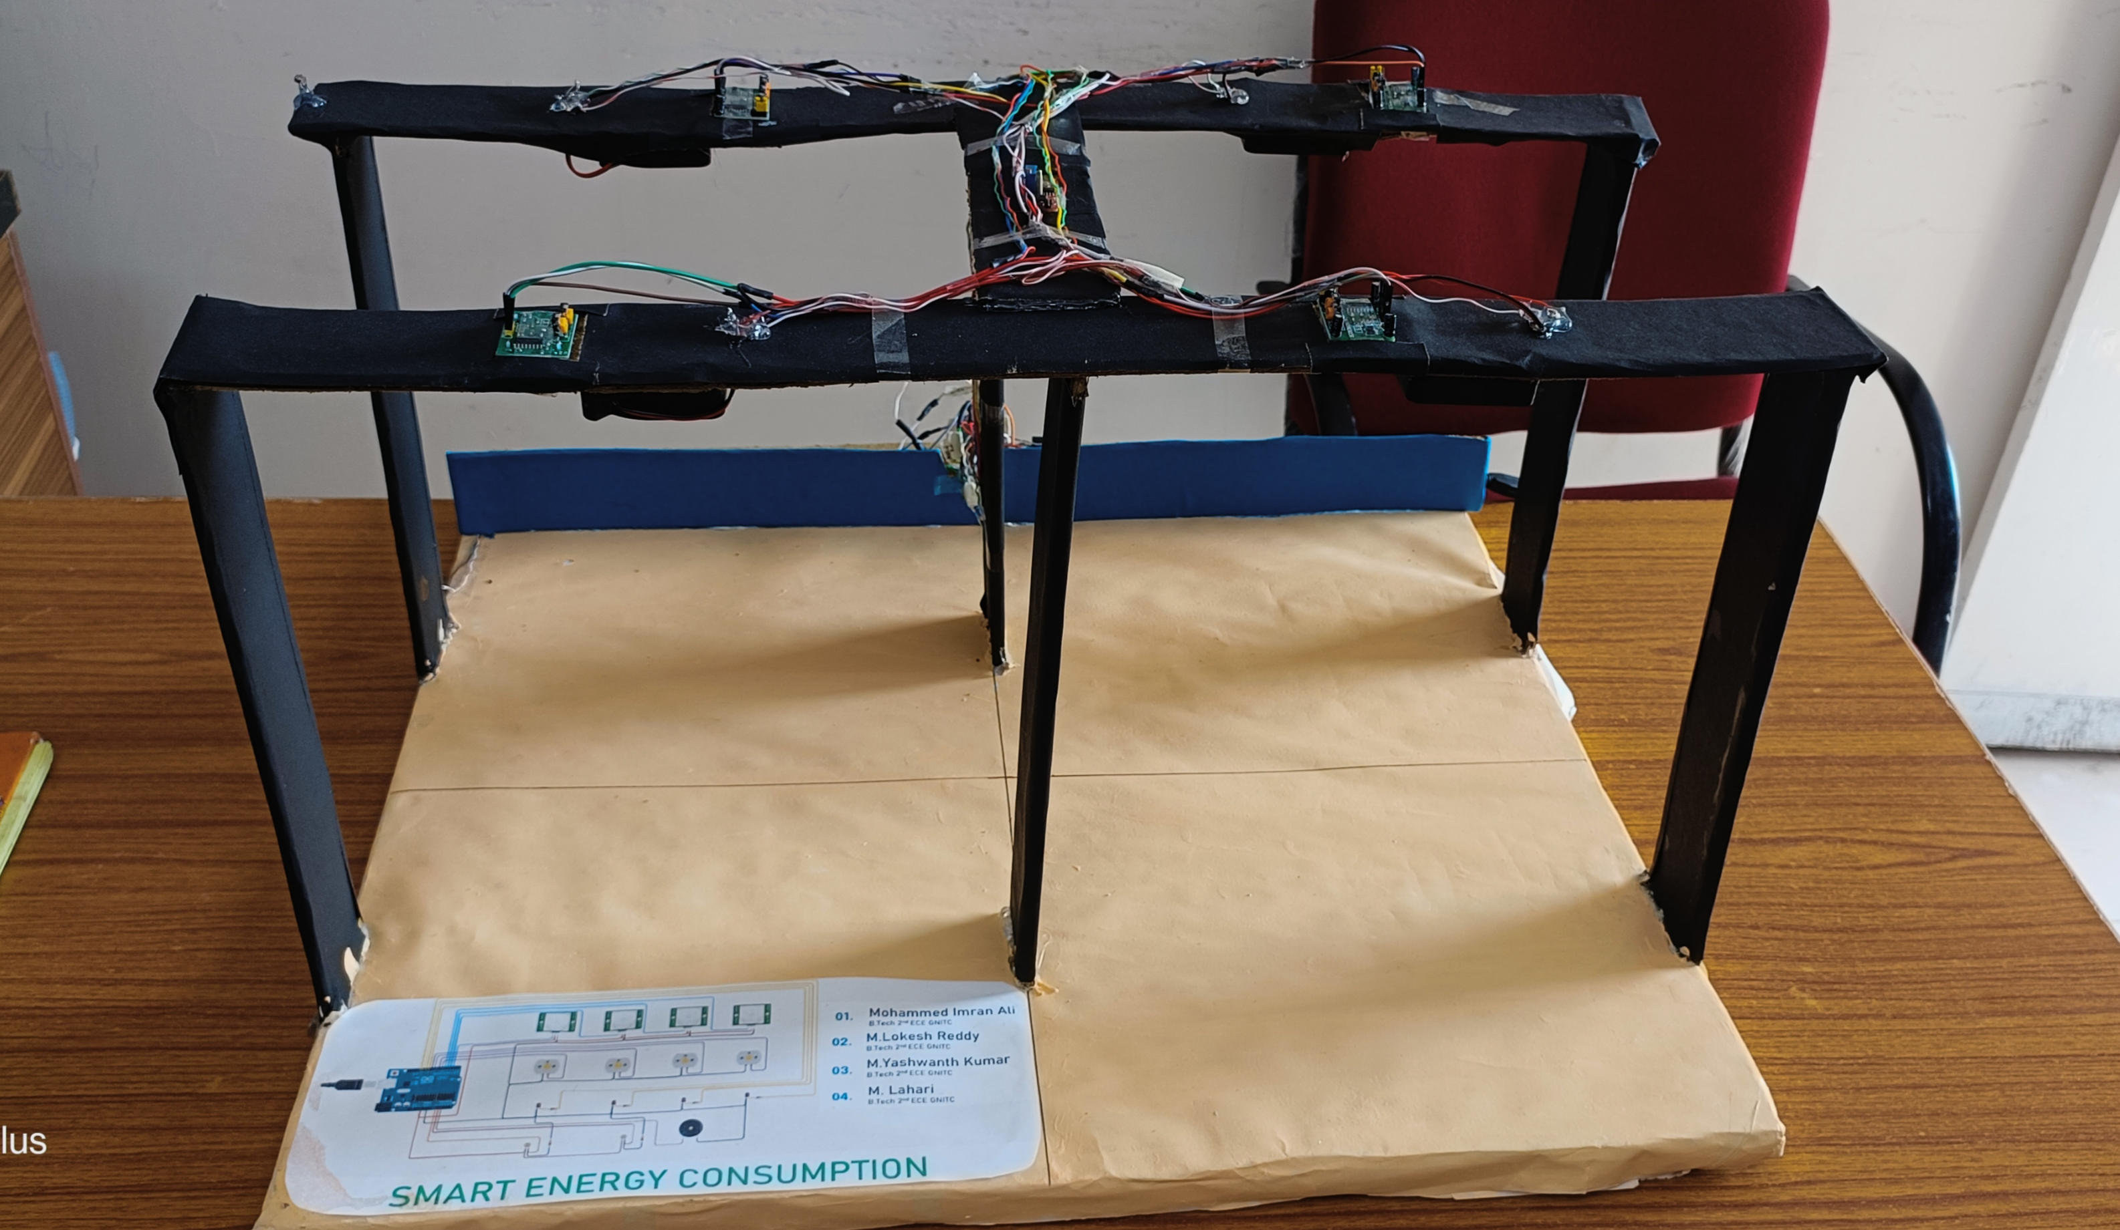
The SEC System has following uniqueness :
Minimized consumption of electricity.
Less carbon emission
Eco friendly, less pollution
Energy conservation
Auto switching.
Low cost, easily affordable for common people
It is also very helpful for physically challenged people.

Slide 14
Social Impact
It help us to minimize the consumption of energy
Here we are saving the non renewable source of energy
We can save the energy for future generation
We can restrict the import of fossil fuel.
We can optimize the energy consumption
This helps us to reduce the power cut.
By using less consumption of energy, we reduce the pollution level

Slide 15
Thanks!

